Slide 1
COM410 Programming in Practice
Class, Subclass, Data Entry, Loops

Slide 2


Reach Out
Email:
serif.salem@qa.com
Serif Refined Material (Password: COM410)
https://tinyurl.com/QACOM410
University Drop Box
https://tinyurl.com/QAULSTER

Slide 3
Content
Common Mistake and Best Practice
Practice of Independent Class running for class, and sub-class
Practice of adding new features to the class.
Practice of creating new sub-class (teacher)
Practice of making the data entry from the user Keyboard.
Practice for the Loop and conditional Loop.

Slide 4
Common Mistake in Java
One of the most common mistakes in Java programming is having a mismatch between the class name and the file name. This can lead to compilation errors, making it essential to maintain consistency.
Java enforces a strict rule that the file name must match the public class name exactly. If this rule is violated, the compiler throws an error.

Slide 5
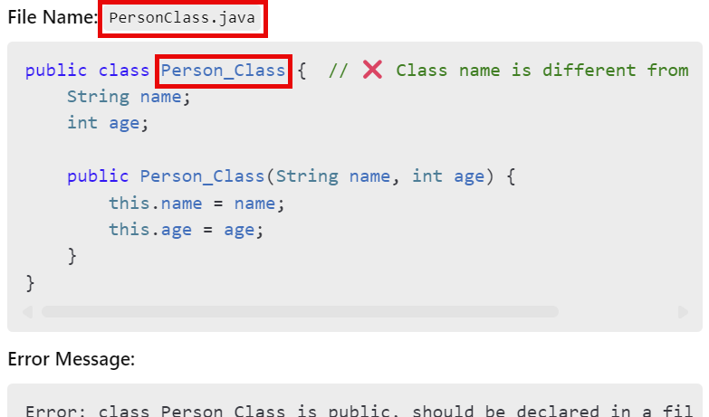
Common Mistake in Java - Example of Incorrect Naming

Slide 6
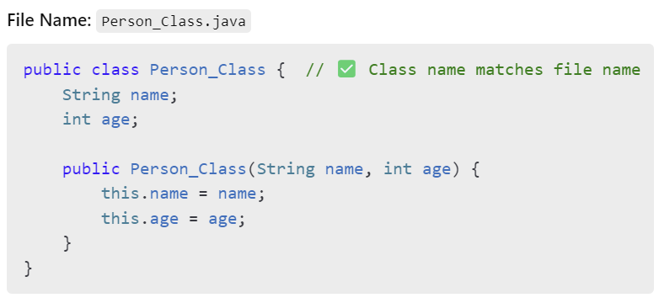
Common Mistake in Java - Example of Correct Naming

Slide 7
Common Mistake in Java
Ensuring consistency between file names and class names is crucial in Java programming. Following this rule will help avoid compilation errors and improve project organization.

Slide 8
Understanding Java Access Modifiers and Main Method
public class
Declares a class that is accessible from anywhere in the project.
Only one public class is allowed per file, and its name must match the file name.
Example:

Slide 9
Understanding Java Access Modifiers and Main Method
public (Access Modifier for Methods & Variables)
When applied to a method or variable, it means it can be accessed from other classes.
Example:

Slide 10
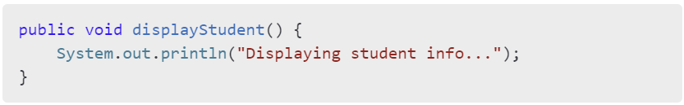
Understanding Java Access Modifiers and Main Method
public void (Method Definition)
Declares a method that does not return a value (void) and can be accessed from other classes.
Example:

Slide 11
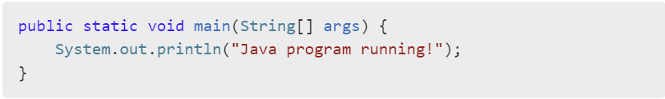
Understanding Java Access Modifiers and Main Method
public static void main(String[] args)
The entry point of a Java application.
static means it belongs to the class and doesn’t require an instance.
void means it doesn’t return anything.
String[] args allows command-line arguments.
Example:

Slide 12
Good Practice: Making Classes Independently Runnable
To ensure that a class can be executed independently while still being callable from other classes, include a main method inside it. This allows the class to run standalone for testing and debugging purposes.
Why This is a Good Practice:
Allows the class to be tested independently without relying on another main class.
Ensures modularity and flexibility in larger projects.
Helps in debugging and verifying individual class functionality.

Slide 13
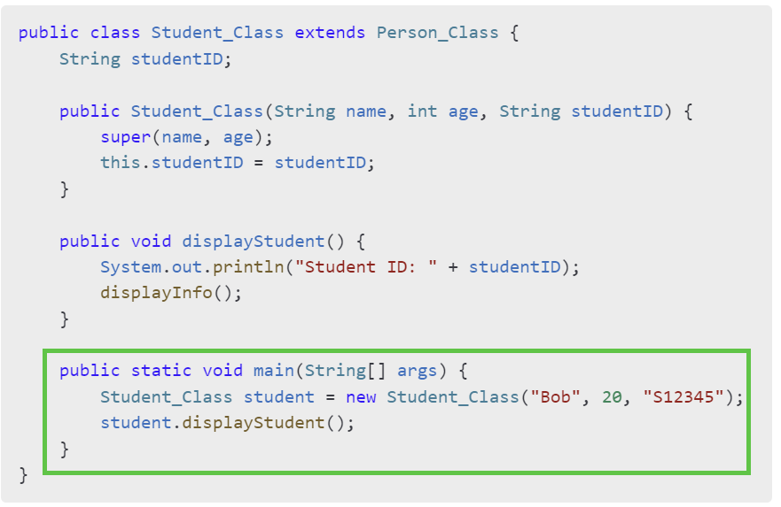
Good Practice: Making Classes Independently Runnable

Slide 14
Practice 1
Object-Oriented Implementation with Inheritance and Independent Execution in Java

Slide 15
Practice 2
Enhanced Java Program Demonstrating Inheritance, Independent Execution, and Additional Attributes

Slide 16
Practice 3
Enhanced Java Program with User Input, Inheritance, and Dynamic Object Creation
How These Versions Work:
✅ Loops until the user enters 0 for age. ✅ Takes user input dynamically for each class. ✅ Main_Objects allows users to choose whether to enter Person, Student, or Teacher data. ✅ Properly handles user input with Scanner to avoid input mismatches.

